Slide 1
Lab5 - Unit Test JUnit

Slide 2
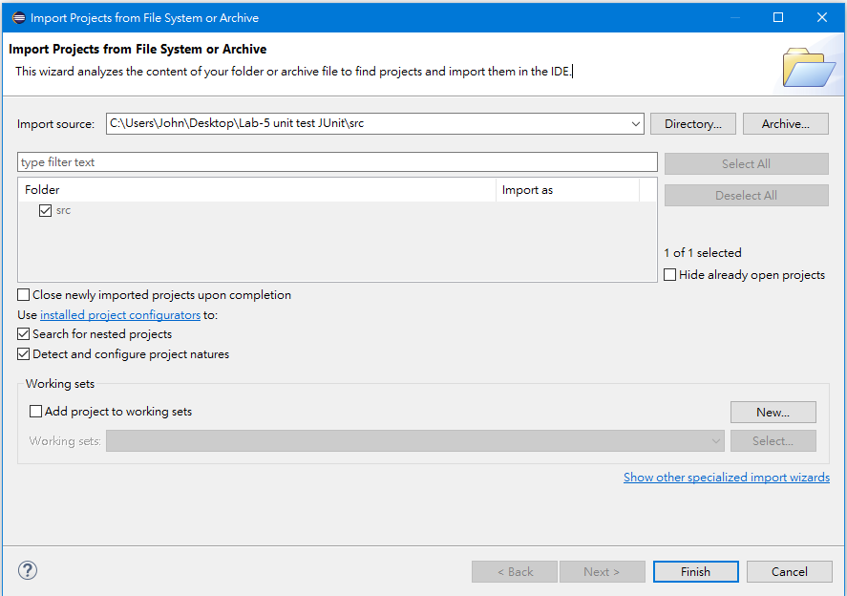
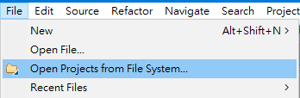
Open Java Project

Slide 3
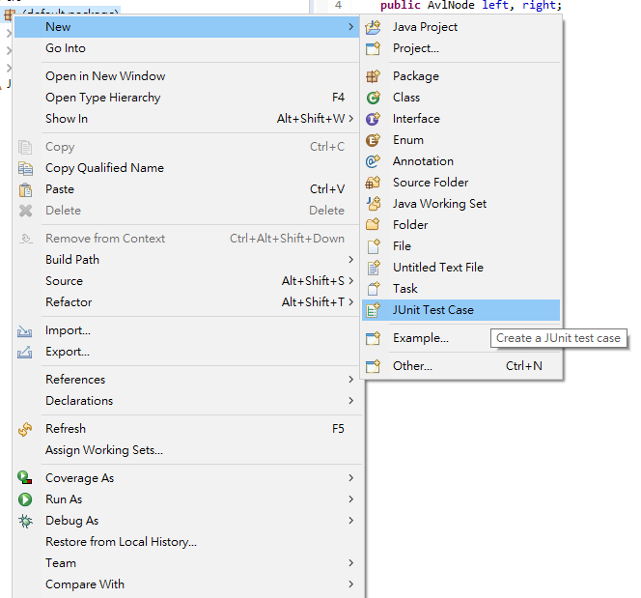
Create JUnit Test Case
Right Click

Slide 4
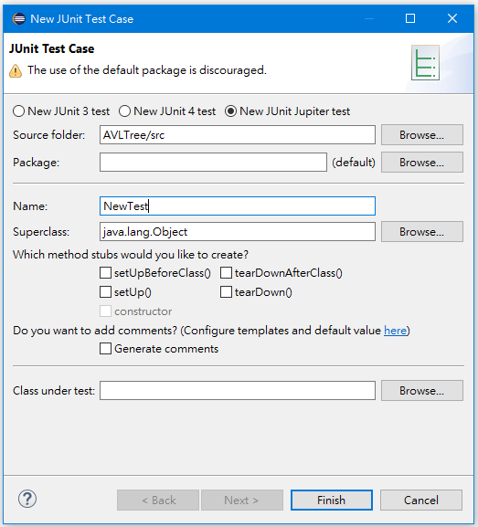
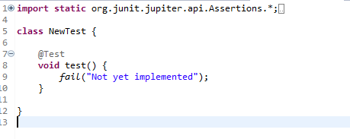
Input Class Name

Slide 5
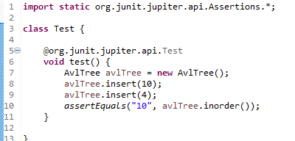
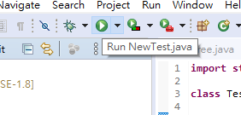
Try To Write Some Test Case

Slide 6
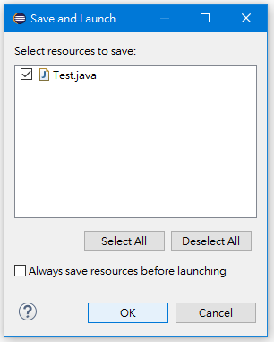
Run The Test Case

Slide 7
Run The Test Case

Slide 8
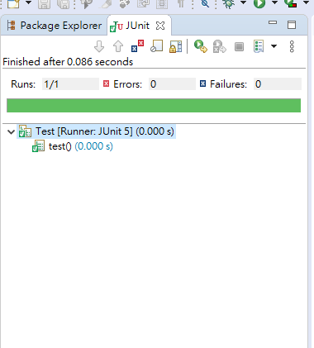
Check Test Result

Slide 9
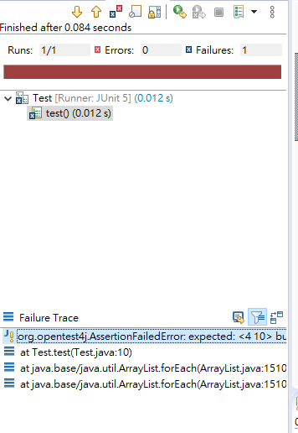
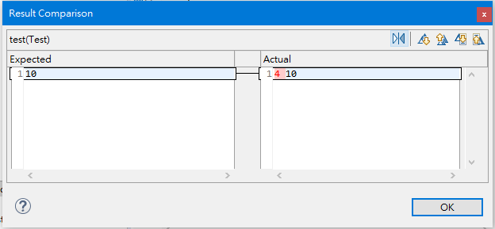
Failure Result
Double Click

Slide 10
Requirement
Write test case by these test data as detailed as possible :
10, 5, 4, 11, 15, 16, 17, 3, 2, 9, 8, 7
2, 5, 9, 14, 13, 17, 6
TA will check if these test data exist in your test case.
And success results like :

Slide 11
Hint
Maybe you can assert :
Inorder/Preorder/Postorder
Search
CountNodes
IsEmpty
To check that is the result meet your expectations or not.

